Slide 1
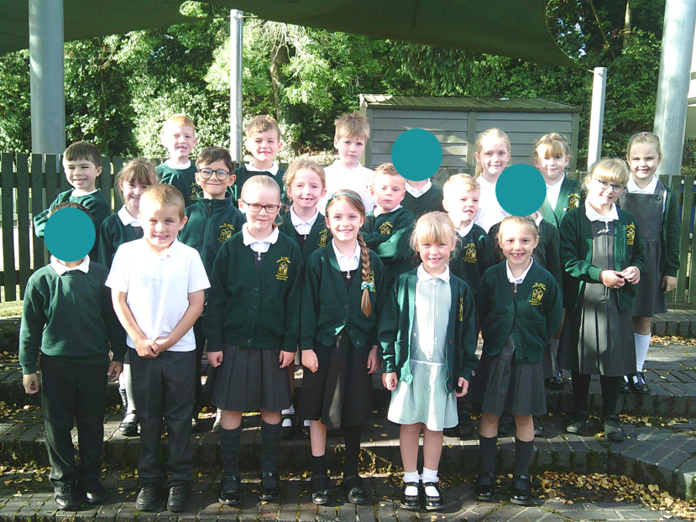
Welcome to Year 2

Slide 2
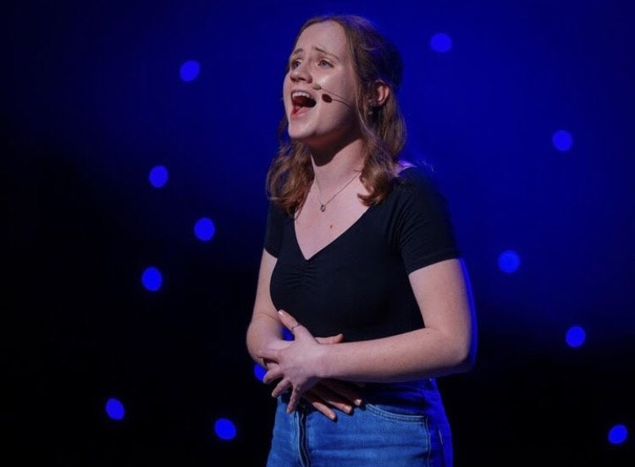
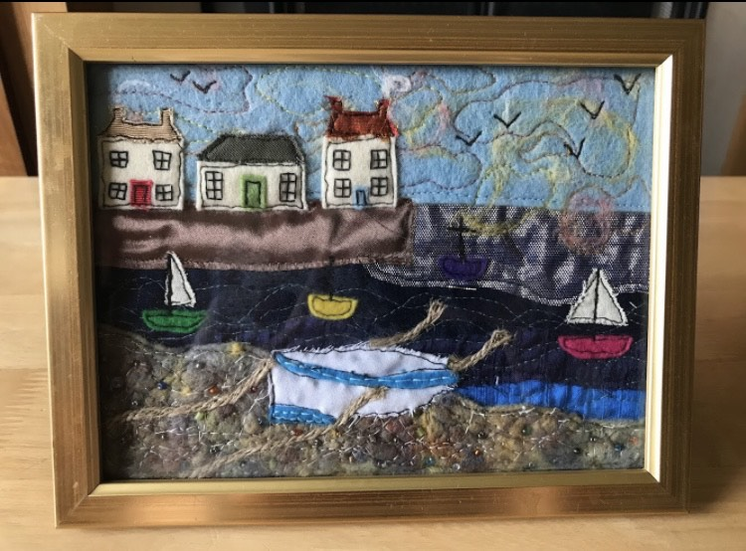
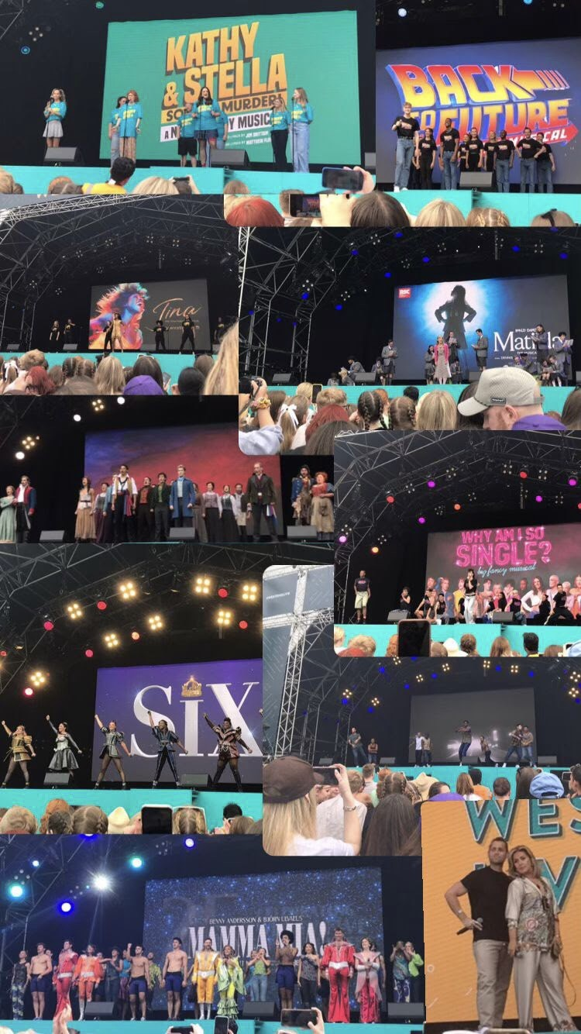
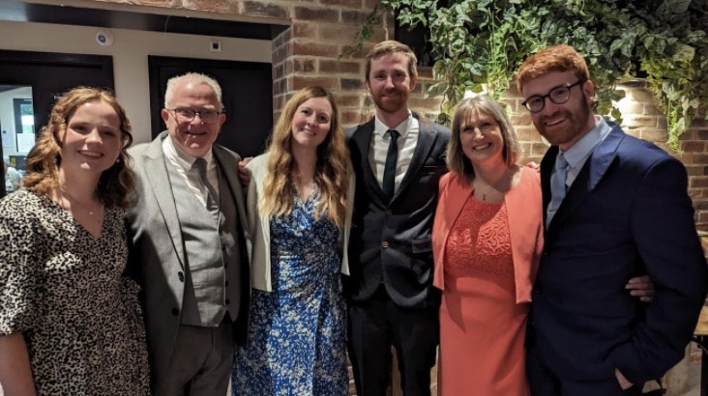
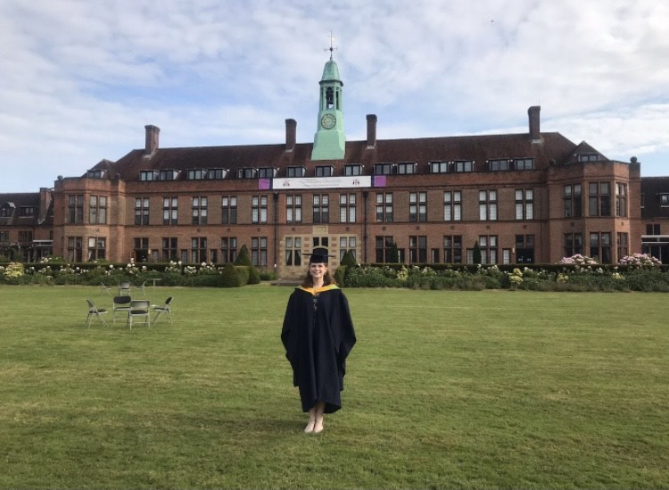
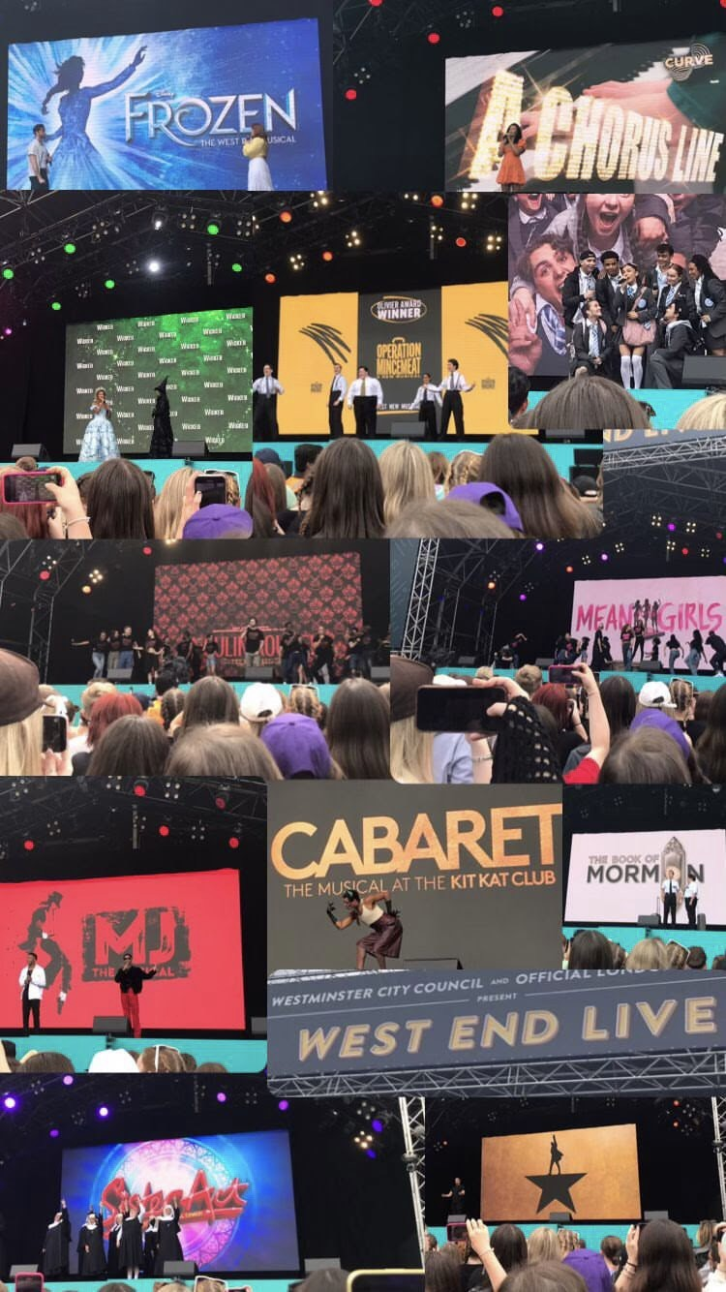

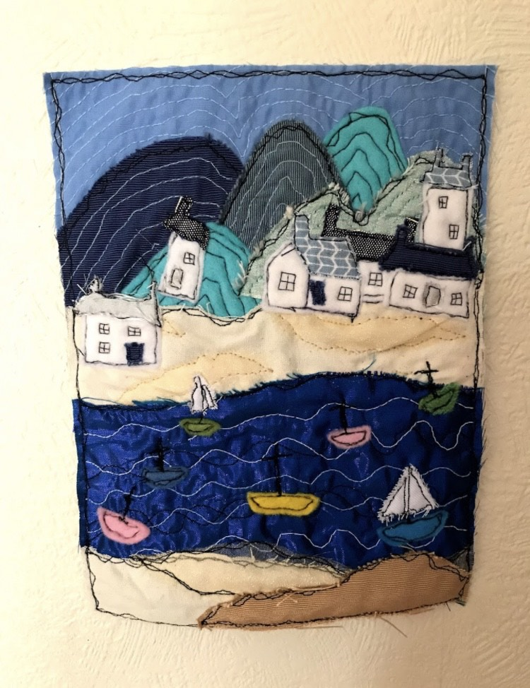
A bit about me…

Slide 3
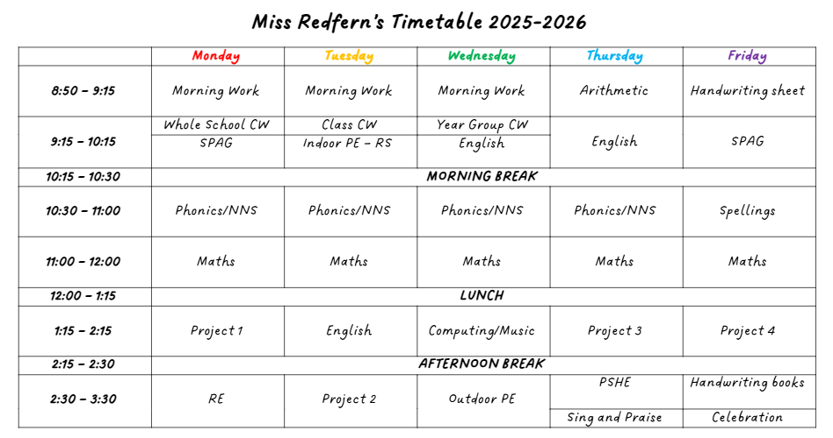
Weekly Timetable

Slide 4
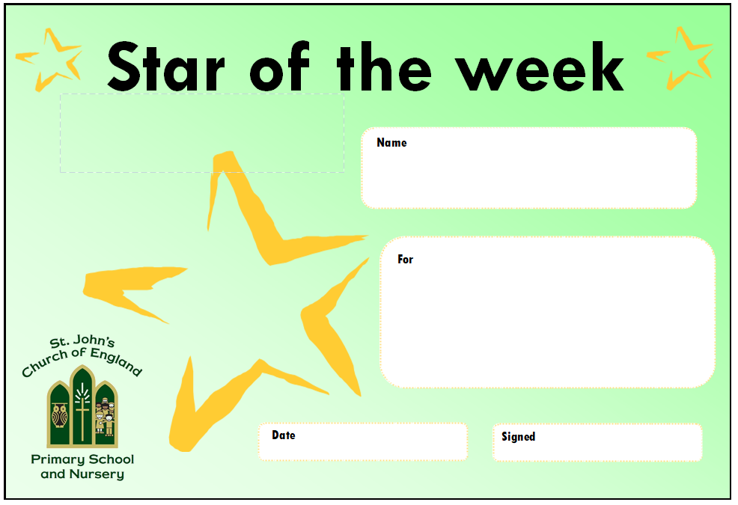





Rewards and Praises

Slide 5



Homework
Read 5 times at home. Reading records will be checked once a week.
Spellings to practice.
  Spellings will be handed out on a Friday and the test will be the following Friday. Spellings was also be available on Google classroom.
Maths and SPaG homework, usually online (later in year)
  This will be set on Friday and should be completed by the following Friday.
TTRockstars (later in year)

Slide 6
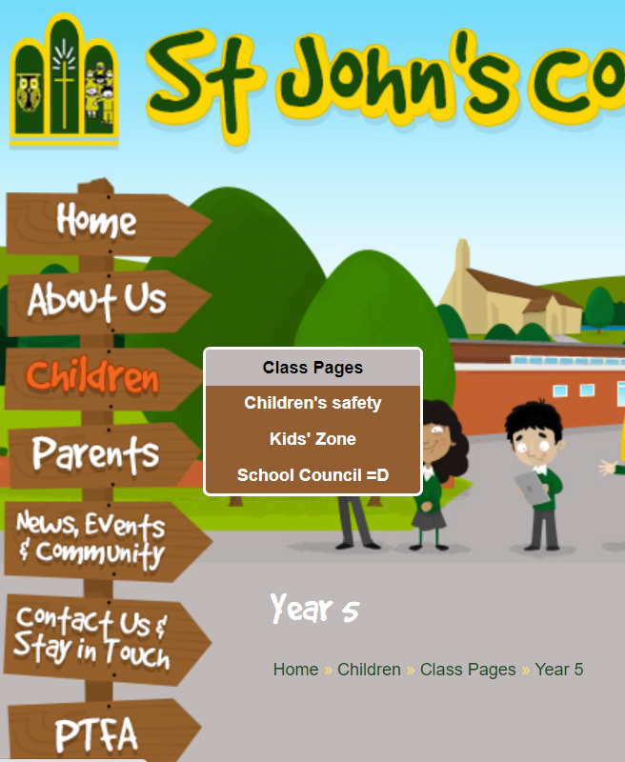
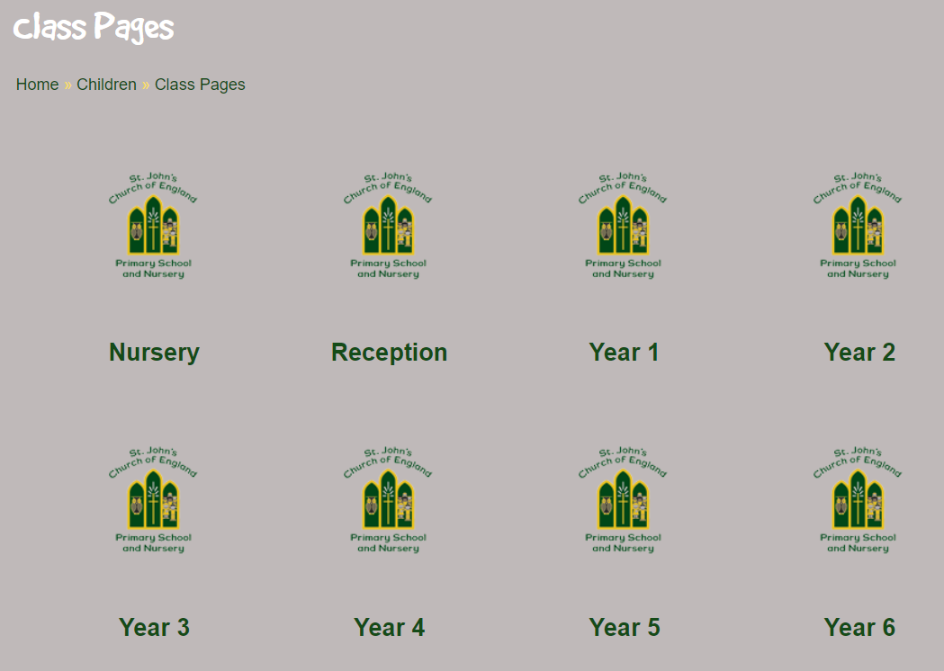
Class page

Slide 7
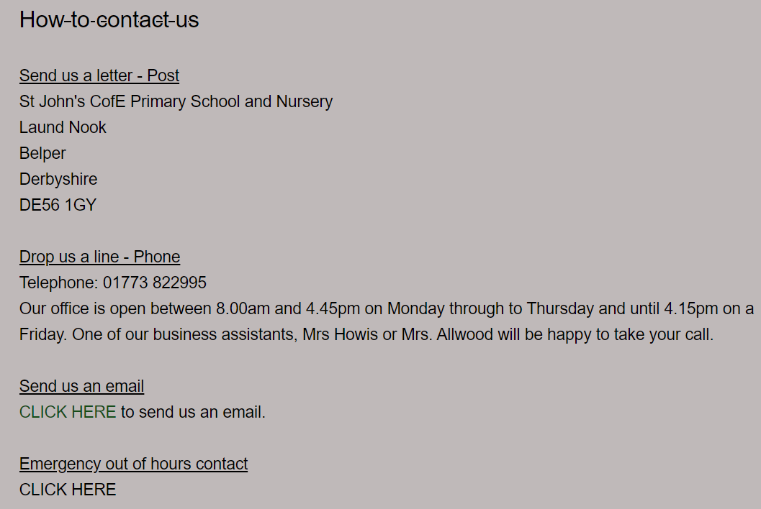
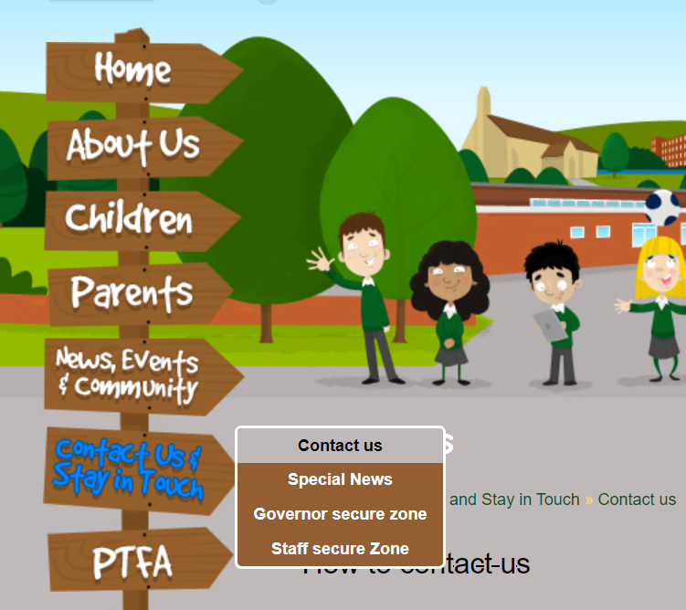
Contact us

Slide 8

Who to contact…
1st port of call
If you have a question or concern, please contact your child’s class teacher as the first port of call (via the means on the last slide)
Further support
If you wish to speak to a more senior member of staff, the next step would be to speak to the infant phase leader (Mrs Newton)
Beyond this support
If you wish to then speak to a member of our senior leadership team, the next person to contact would be Mrs Carvell (Deputy Headteacher)

Slide 9
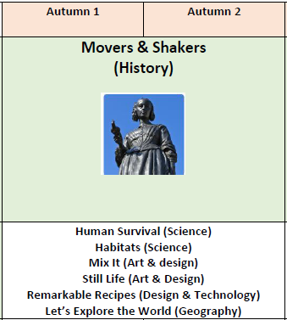

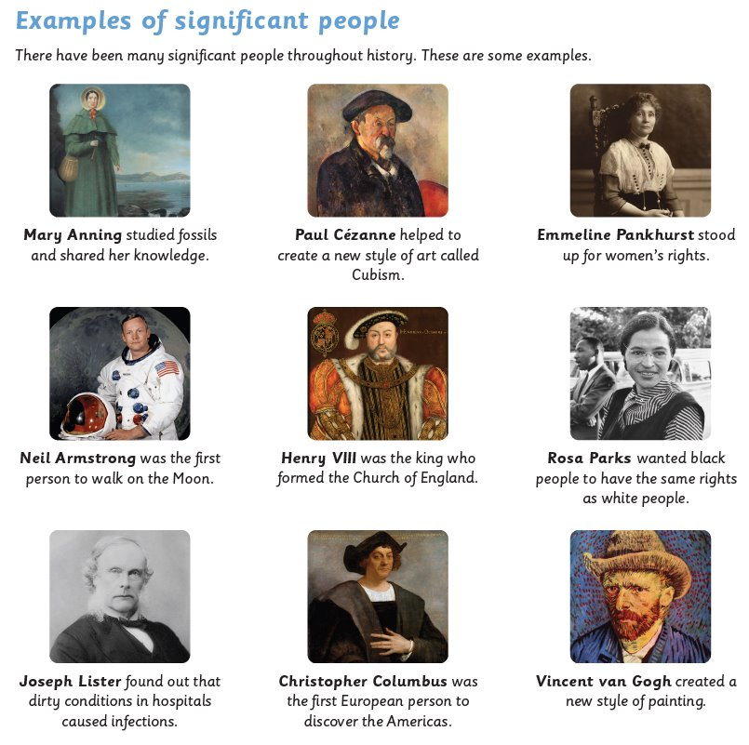
Our projects -Autumn

Slide 10
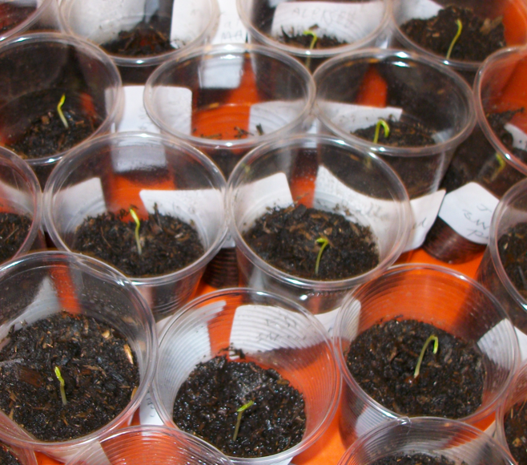
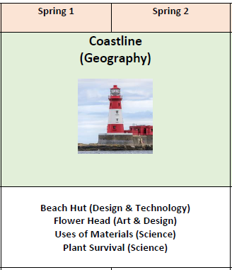
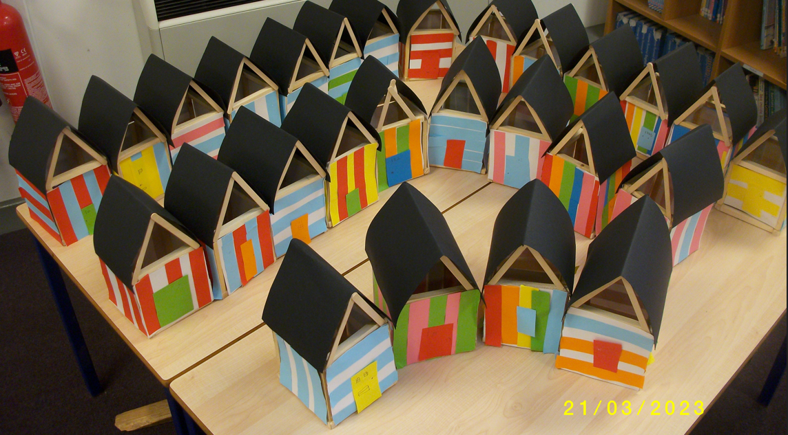
Our projects – Spring

Slide 11
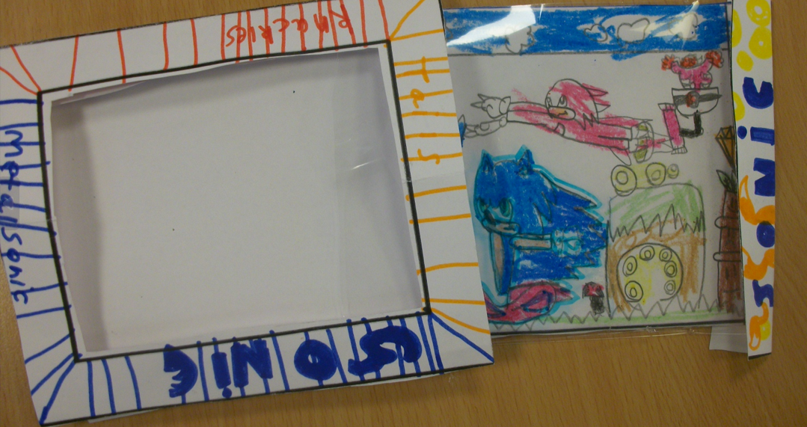
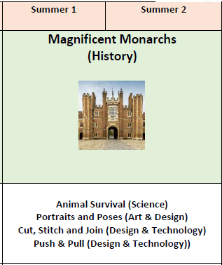
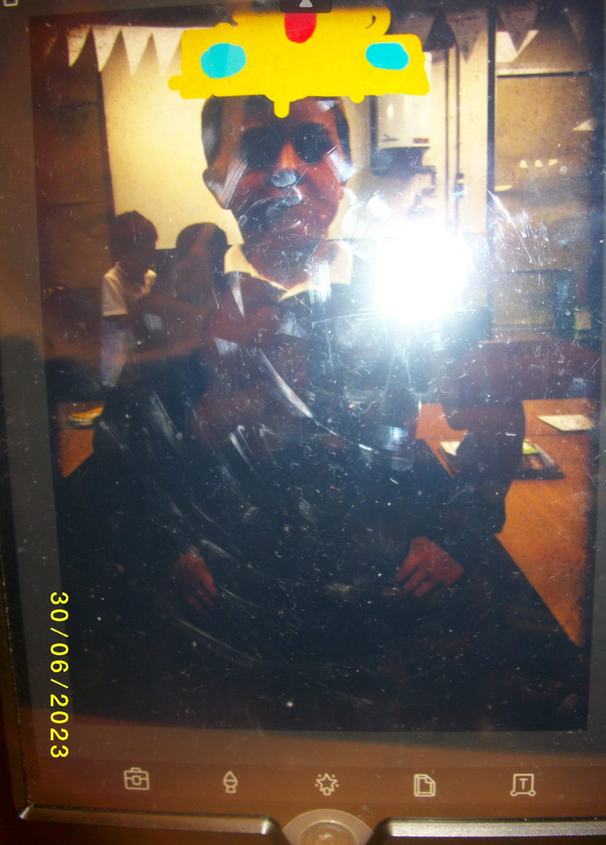
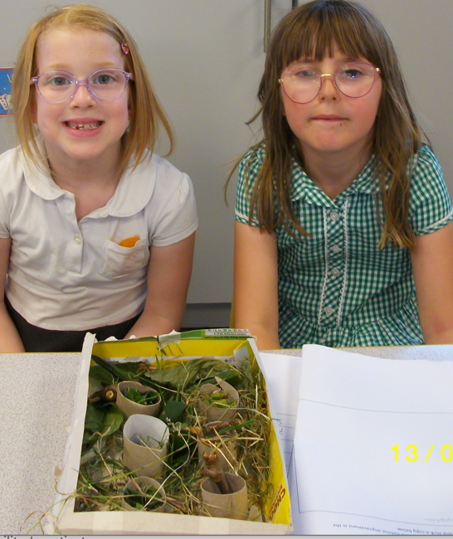
Our projects – Summer

Slide 12
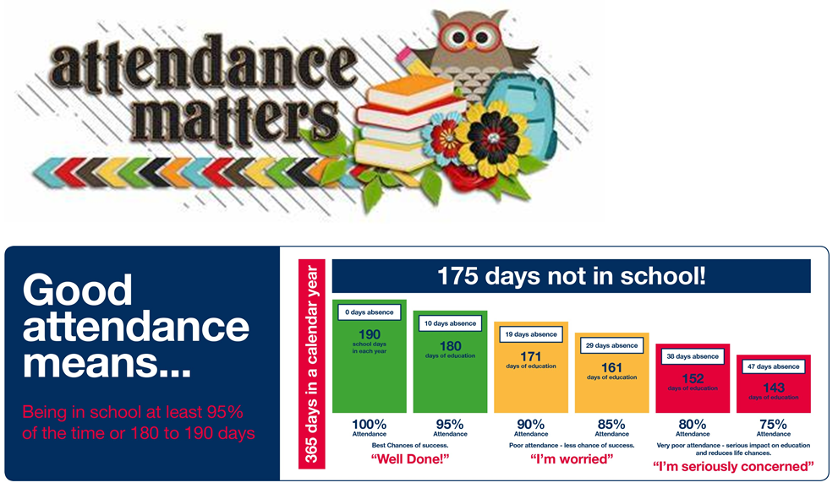

Slide 13
Other essential info
PE is on Tuesday and Wednesday.
Where possible, please send your child with a book bag and not a rucksack as there is limited space
Treat snacks: Monday and Friday, healthy snacks- Tuesday to Thursday (fruit is available daily)
Children should have sports lid water bottles and not screw lids to prevent spillages.
Uniform – please name all uniform, coats, and PE kits
PE kit – to be taken home at the end of each half term

Slide 14
In Year 2…
Optional SATs- these will take place in May 2026.
Accelerated Reader- some children will take a ‘Star Test’ before October half term if appropriate. This will give the child a range of book they can choose from (eg: 1.5-2.2). Children can then read a book of their choice at home with a parent/ carer and take a quiz in school to assess their comprehension of their reading.
Decodable books- we will continue to read these until October half term and beyond for the children for whom it is appropriate.
Share a story books- these will continue to be sent home.
Make sure reading records are in school each day.
Walking to church – helpers always needed for our termly church services

Slide 15
Any questions?
Time to look around the room
to look at work and books so far and,
if you wish to speak confidentially…

