Slide 1

Phonics Screening Check
Information Workshop

Slide 2
TABLE OF CONTENTS
01
02
03
04
Questions
Helping at Home
Essential Letters and Sounds
Phonics Screening Check
Notes:
Before we look at PSC, new Phonics scheme. Semantics of PSC. How you can help us to prepare your child or children for the PSC. Questions with staff.

Slide 3

01
ELS
Essential Letters and Sounds

Slide 4


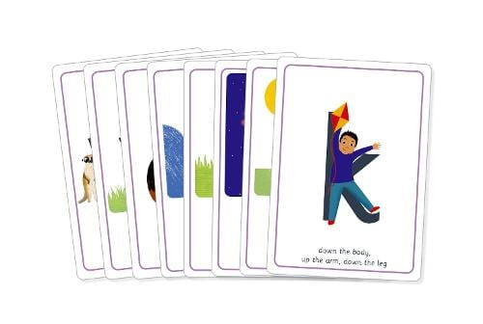

Essential Letters and Sounds
The Reading Framework (2022)
Validated Systematic Synthetic Phonics Scheme
Lessons and Resources
Exciting lessons and flashcards – available to see today
New Reading Books
Carefully matched to your child’s phonics knowledge

Slide 5

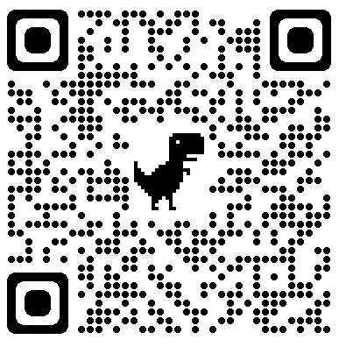
EYFS2 Coverage (Phases 2, 3 & 4)
Pronunciation video phase 3

Slide 6
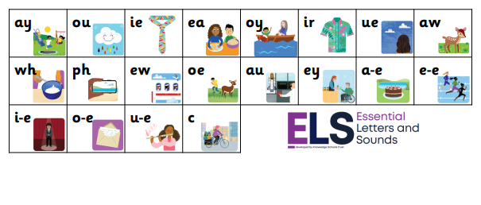
Year 1 Coverage – (Alternatives (Phase 5)
Notes:
Each with their own rhyme to learn

Slide 7
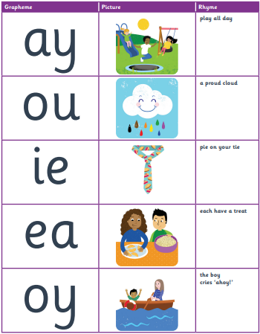
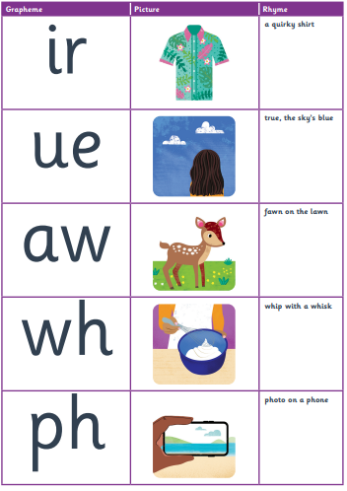
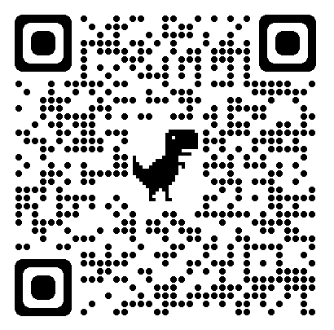
Pronunciation video phase 5

Slide 8

Year 1 Coverage – Further Alternatives

Slide 9

02
Phonics Screening Check
Week commencing Monday 10th June 2024

Slide 10

PURPOSE
‘The purpose of the phonics screening check will be to confirm that all children have learned phonic decoding to an age-appropriate standard’ - DfE

Slide 11
HOW IT WORKS
Your child will sit with a teacher that is familiar to them and be asked to read 40 words aloud.
Your child will be asked to use their blending skills to read the words.
If your child is struggling, the teacher will stop the check. The check is carefully designed not to be stressful for your child.

Slide 12
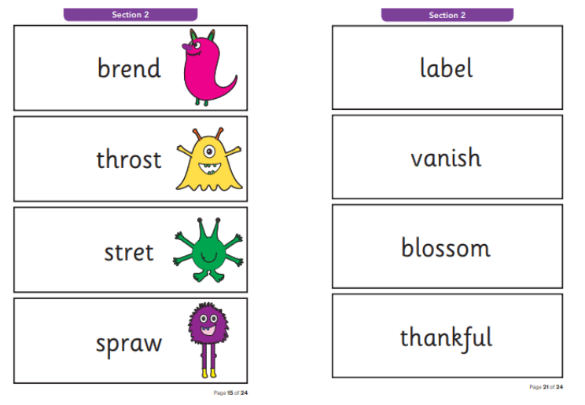
CONTENTS
The Phonics Screening Check will consist of:
20 real words
20 pseudo / alien / nonsense words

Slide 13
PSEUDO WORDS
The pseudo words provide the purest assessment of phonic decoding because they will be new to all children, and so there will be no unintended bias based on visual memory of words or vocabulary knowledge.
The pseudo words will be presented with a picture prompt (aliens / creatures).

Slide 14
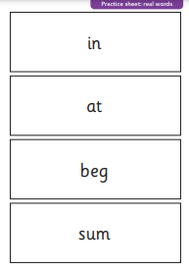
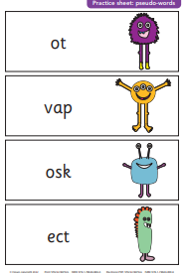
STRUCTURE
There will be some practice words for children before the assessment begins.
These words should help familiarise children with the activity and provide some less difficult words to ease children into the Phonics Screening Check.
Children will have practised throughout the year with Year 1 staff.

Slide 15
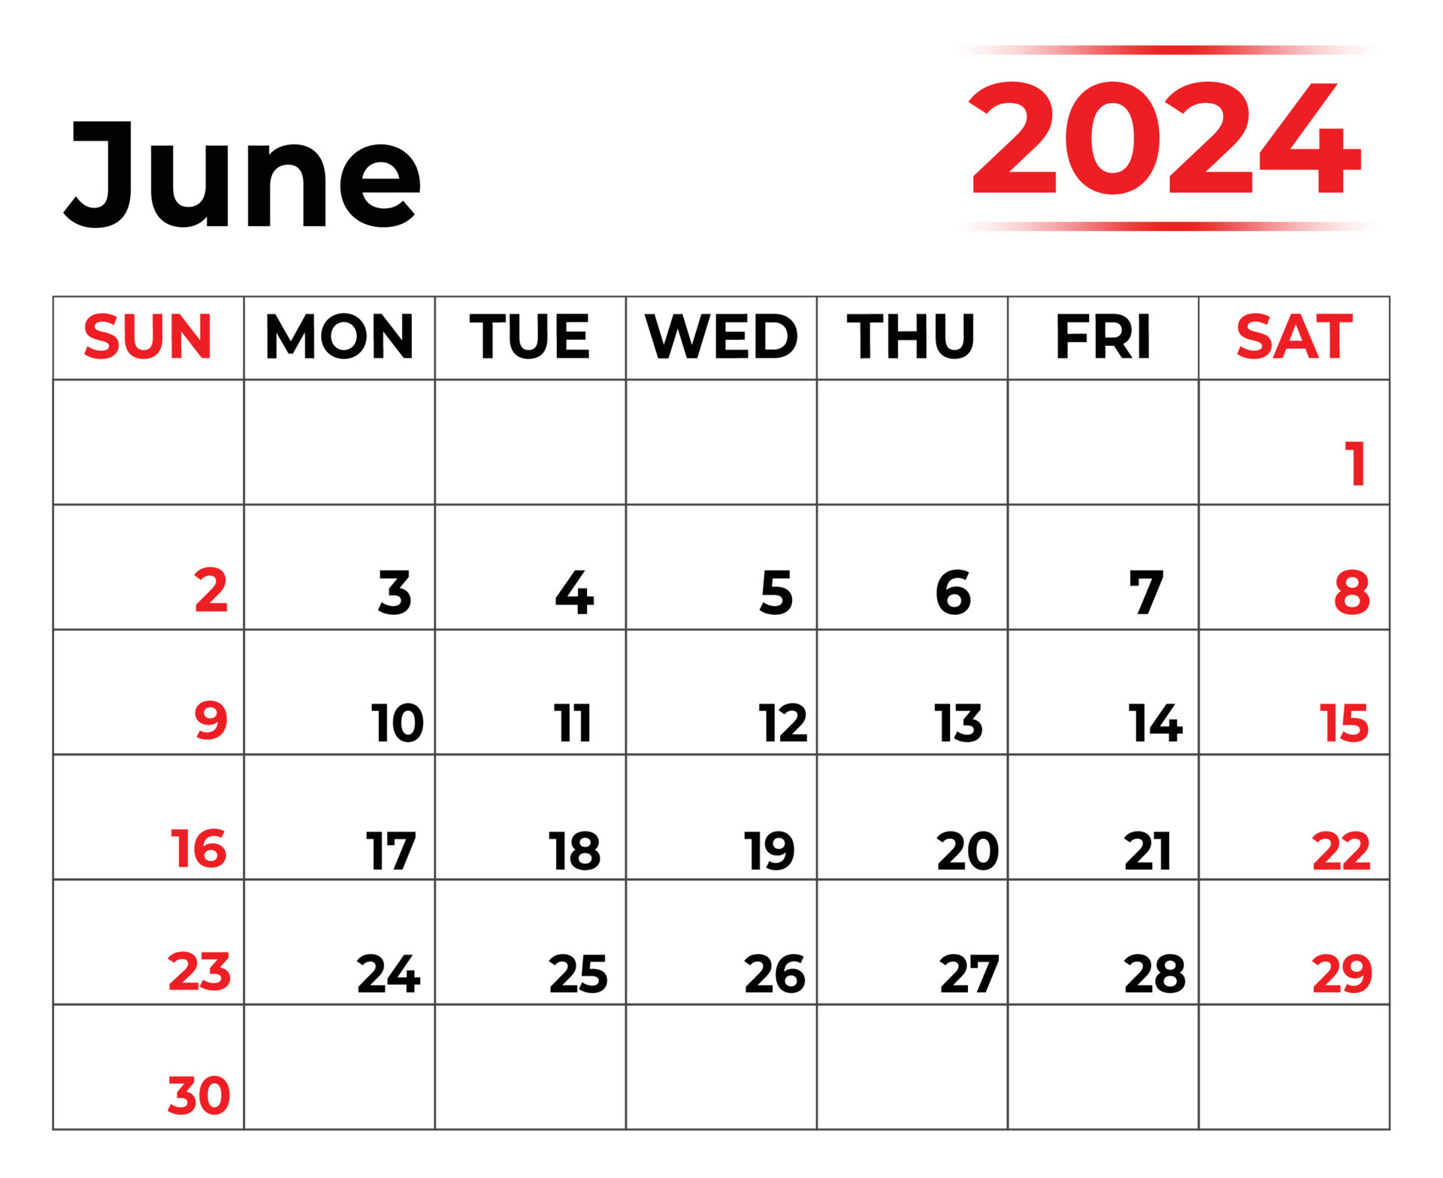
WHEN?
Week Commencing
Monday 10th June 2024.
Threshold released once all schools have submitted their data by the specified date.

Slide 16
RESULTS
You will receive a copy of your child’s results with their annual report.
Children who did not reach the threshold will be given additional help and resit the Phonics Screening Check in 2025.

Slide 17

03
Helping at Home
How to use resources with your child

Slide 18
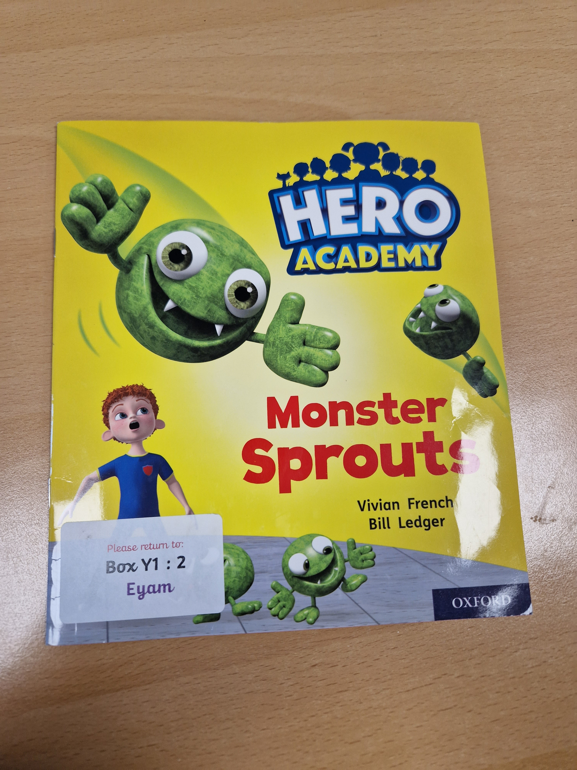

Slide 19
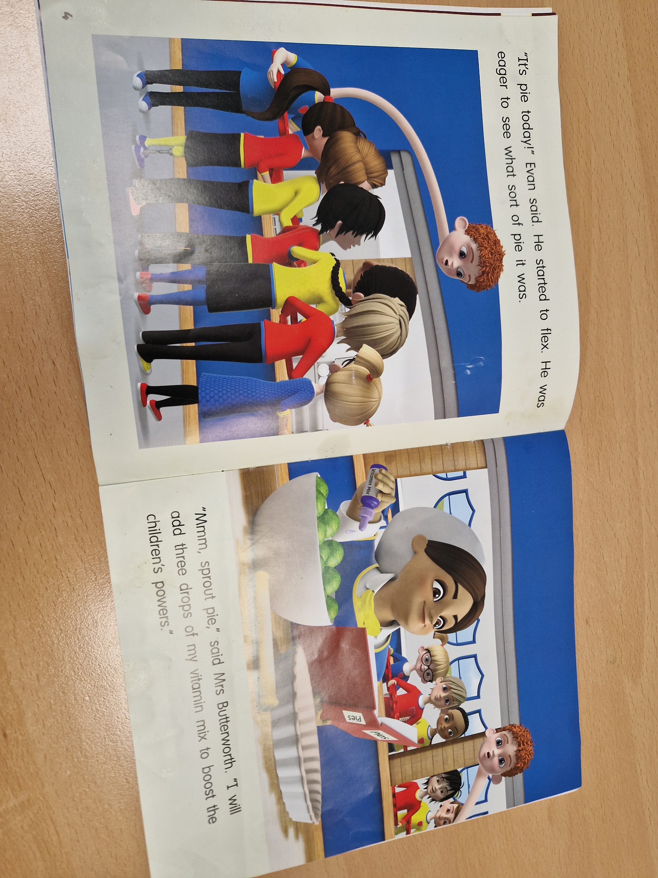

Slide 20
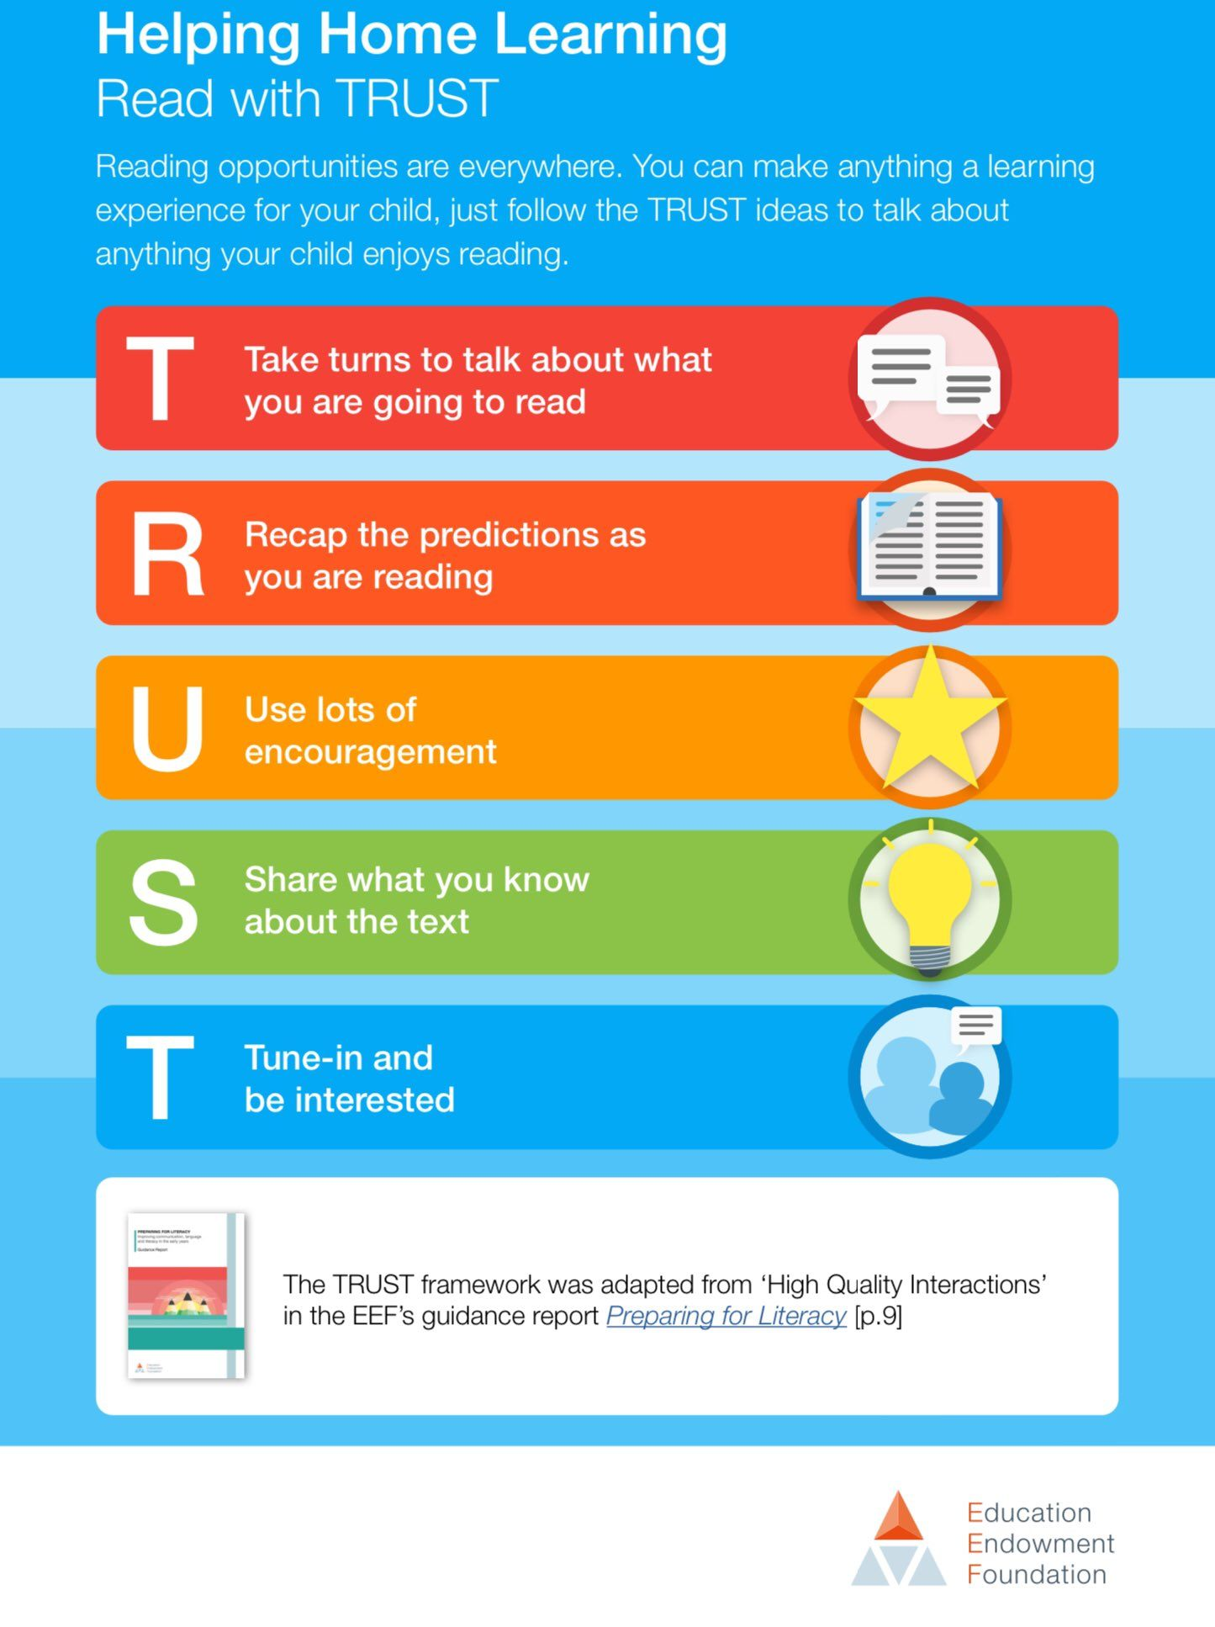
Notes:
Reading is the key to the curriculum – not just for the check. Other strategies from the EEF in packs. Phase 5 flashcard rhymes, decodable and pseudo and top tips

Slide 21
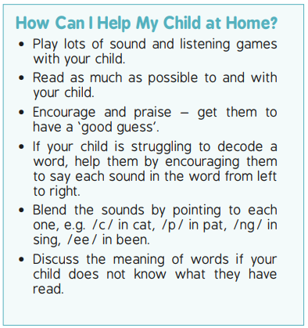

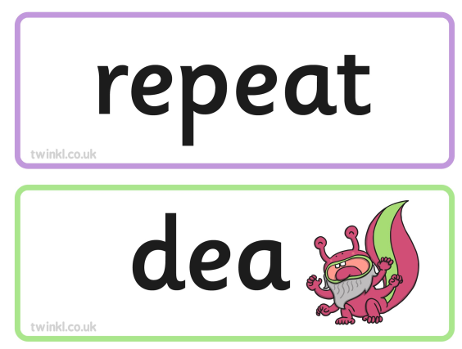
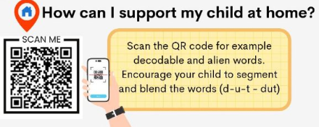
READING 5X A WEEK
Decodable and Share a Story books
FLASHCARDS
These are in your pack.
PSEUDO WORDS
Practise these decodable real and pseudo words with your child

Slide 22

04
Questions

Slide 23


