Slide 1
Calendar and catch up
2.7.20

Slide 2
Two pieces of information shared last night with teachers

Slide 3
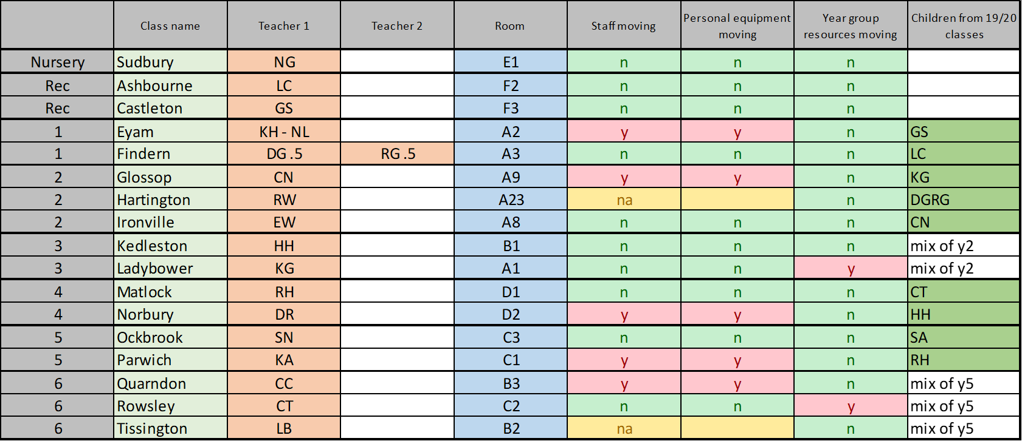
1) Locations for next year

Slide 4
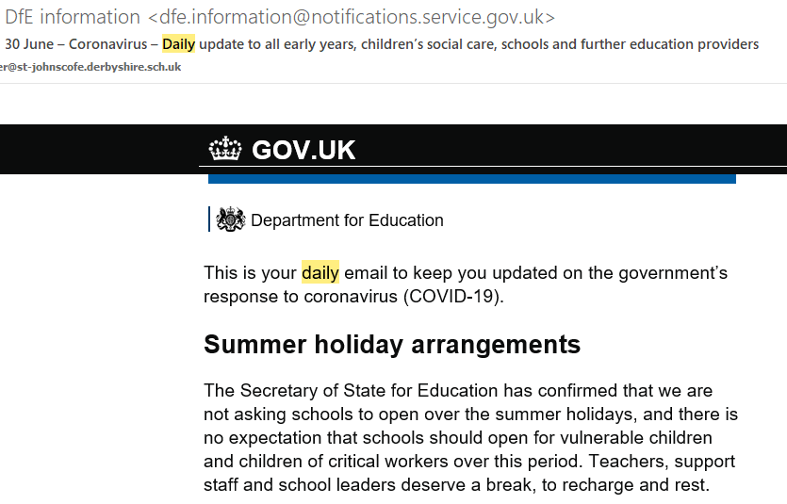
2) Summer holidays

Slide 5
Support staff locations
Leadership team tonight and then KH working on Friday
KH able to talk to TLA’s on Monday to tell them where they will be working – to be kept in confidence
Published at meeting next week on Wednesday 8th.

Slide 6
Children’s books and work
To be sent to new classrooms – and not sent home to ensure fair treatment for children not in school.
Most of it will be able to go home first week in September
Maths and English books to be used by staff and pupils to help with the 5.5 month transition for the majority of our pupils and go home later in the autumn term.

Slide 7
July 4th Social distancing 1m+
No planned changes in school provision for the remaining fortnight at school at present.

Slide 8
September 2020
Guidance published this morning
  https://www.gov.uk/government/publications/actions-for-schools-during-the-coronavirus-outbreak/guidance-for-full-opening-schools
School is continuing to plan for full opening for all pupils in September.

Slide 9
Friday morning, 3rd July, 7.45am
Internet will be switched off.
No server, printer.
Should be back on within 30 minutes.

Slide 10
Policy updates
PE – and three risk assessment
Maths calculation policy and Maths policy
Maternity/paternity/adoption/parental leave
P:\Policies and legislative paperwork\Draft policies under review or construction

Slide 11
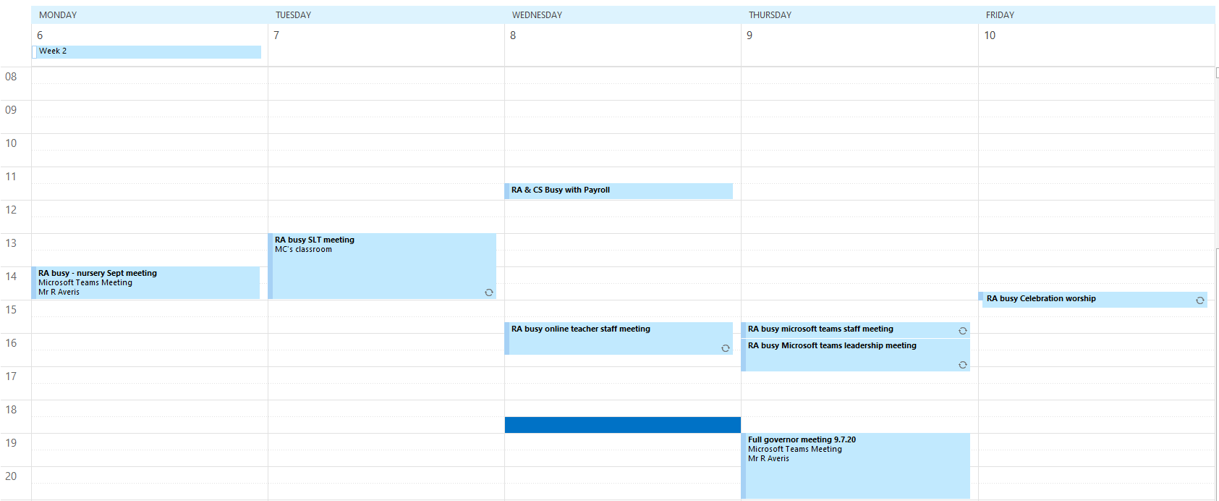
Calendar for next week

