Slide 1

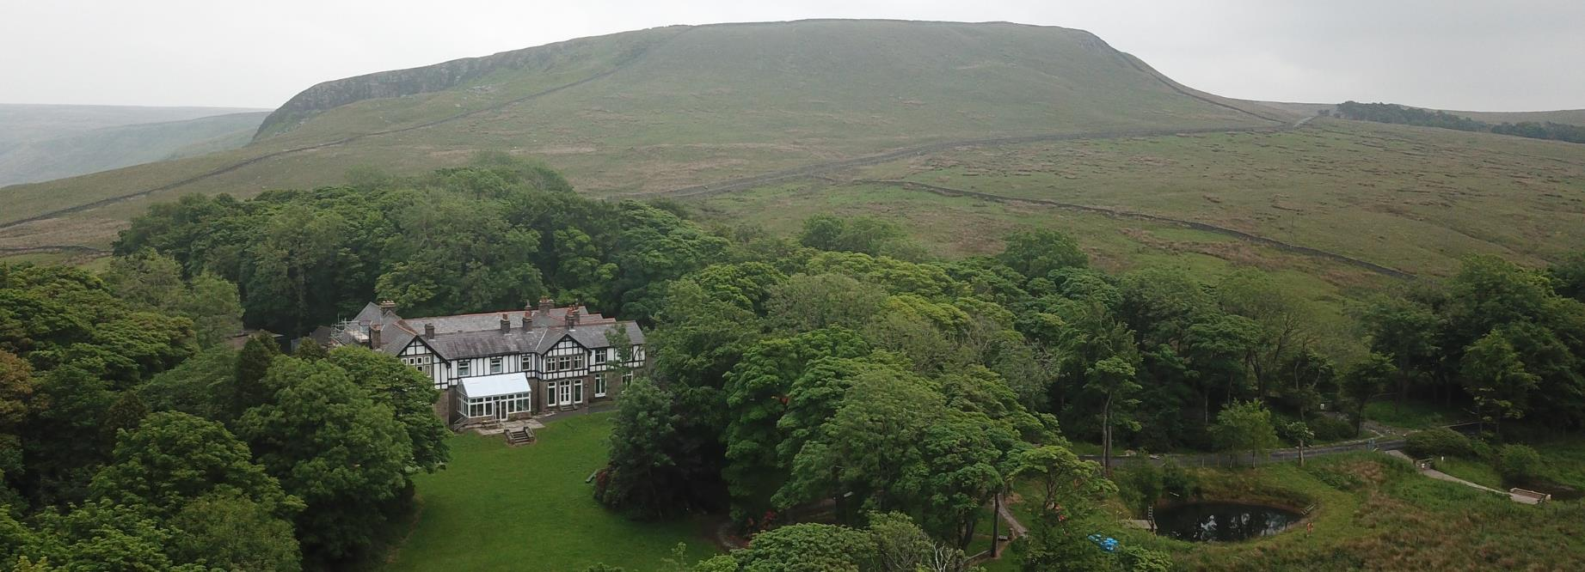


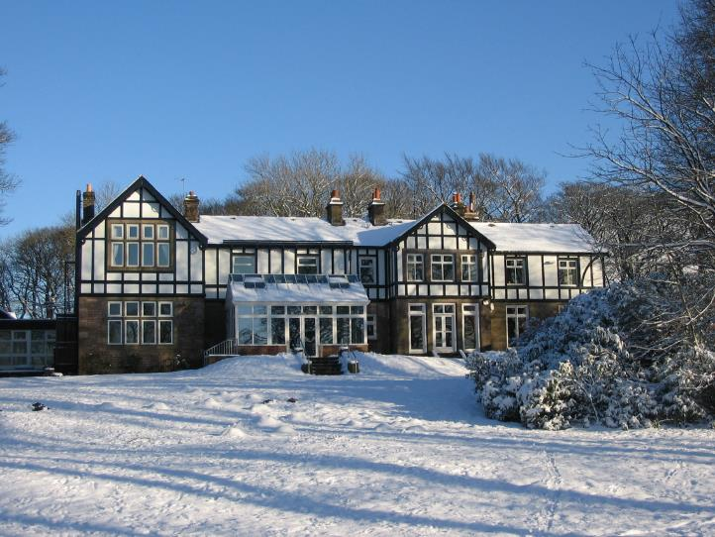
Notes:
We recommend that you have the info for staff and parents handy so any extra questions can be asked.
Each slide has notes if needed.
This is not timed so you can go at your own pace.

Slide 2


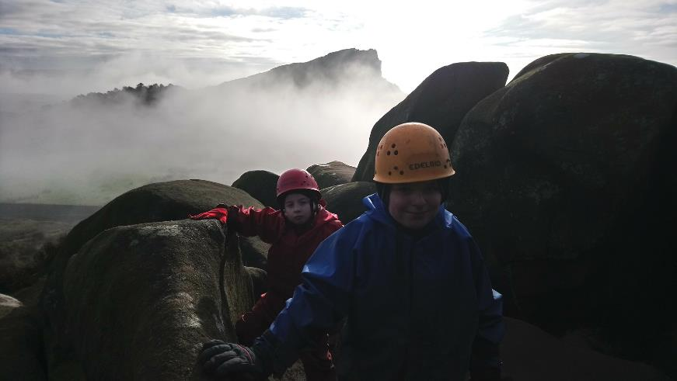

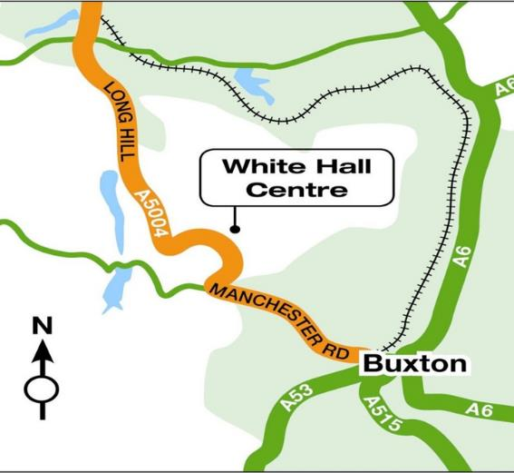
Where are we?
In the heart of the Peak district
Notes:
White hall is in the heart of the Peak District. In the Peak District National Park and 4 miles outside Buxton. At 400 meters White Hall has stunning views of the Goyt Valley and the moors around. Visits to White Hall experience the large grounds (35 acres of woods, ponds and fields) but also the stunning countryside around.

Slide 3
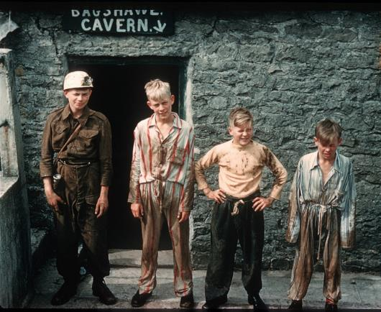
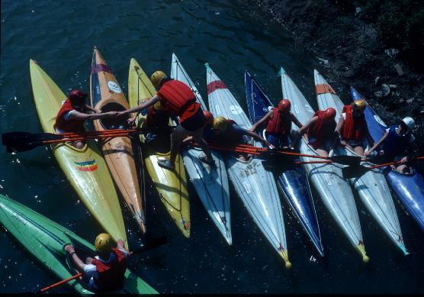
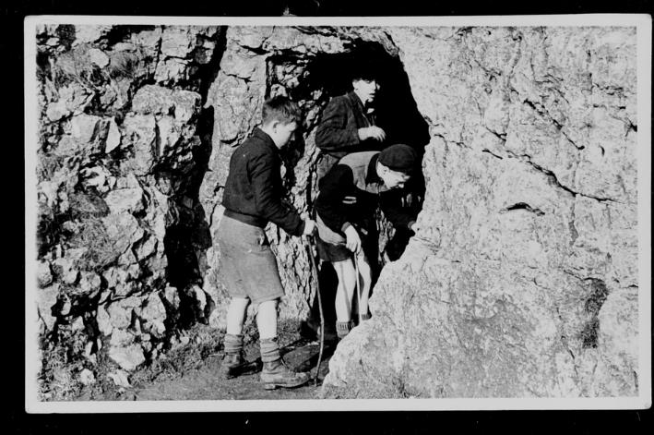

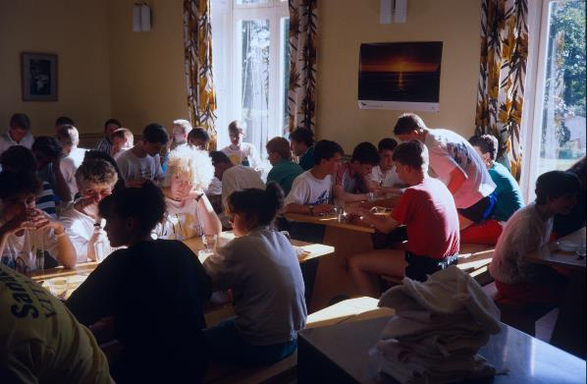
70 years plus of outdoor provision
Personal development and education has been at the heart of White Hall from the beginning.
Notes:
White Hall was the first local authority outdoor education center in the UK. Over those 70 years over a million young people have experienced the White Hall Adventure. It has also trained many instructors, teachers and youth workers in that time.

Slide 4
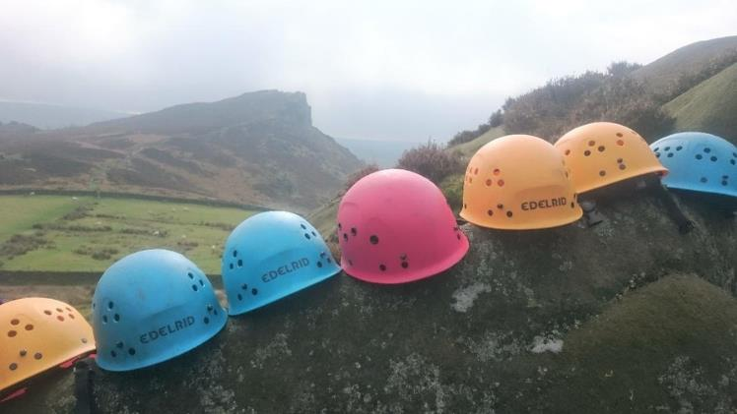



Why come to White Hall?
Notes:
The courses, which White Hall and school plan includes exciting adventure activities using real rock, caves, lakes and hills.
White Hall has robust safety procedures and policies. The safety and welfare of everyone who comes to White Hall is the priority.
White Hall holds a licence from the National Adventure Activity Licencing Authority –this means they are approved to deliver outdoor activities. It indicates and assesses that the centre has been inspected with attention paid to their safety management systems and that they work to nationally accepted standards of good practice.
They also hold the Learning Outside the Classroom Award.
All of the instructors are highly qualified in the activities they deliver and have a wealth and depth of experience of working in outdoor education.
They will do everything they can to ensure the experience will be safe, educational and fun in a caring, welcoming environment.

Slide 5
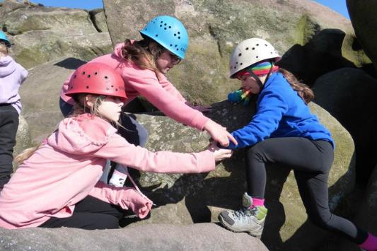
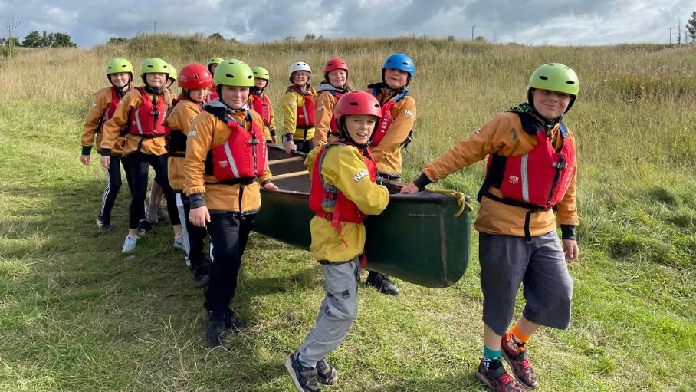
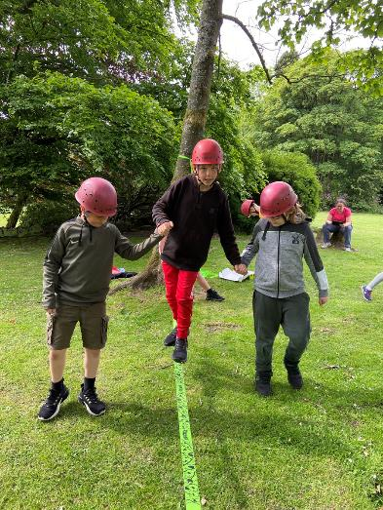
To encourage working together

Slide 6
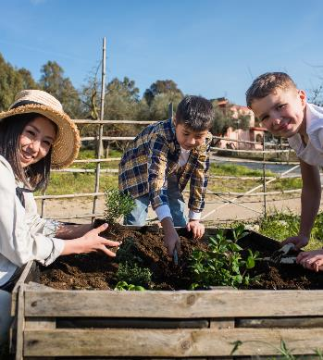
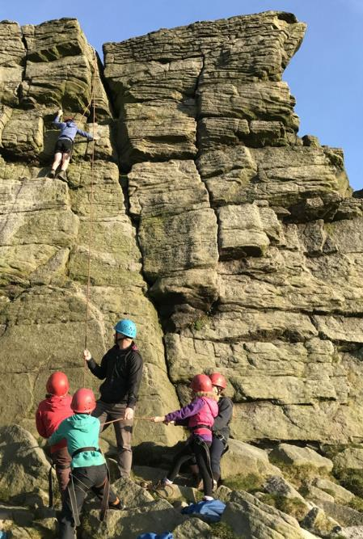
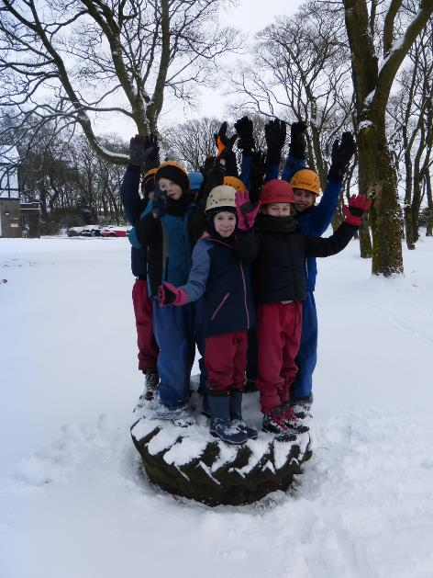
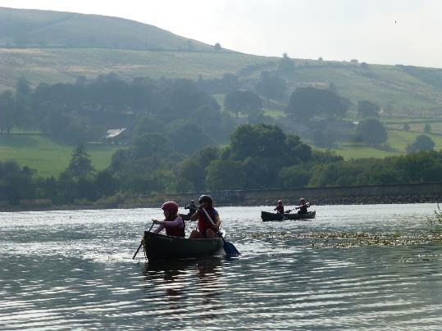


Improve communication skills

Slide 7
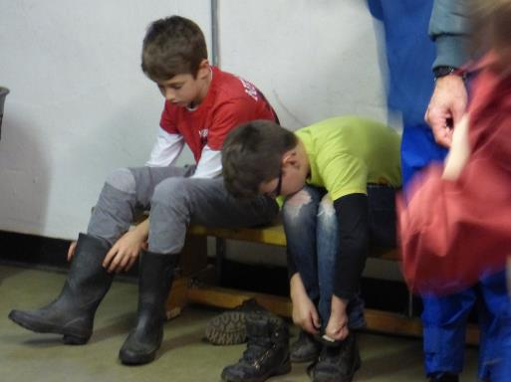
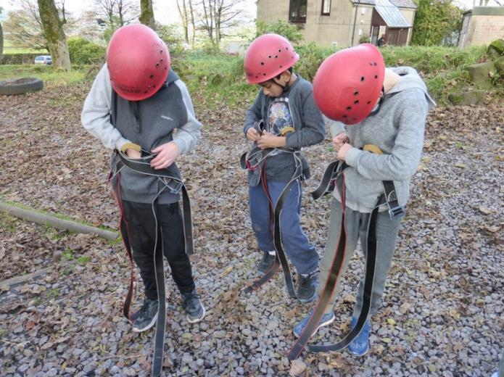
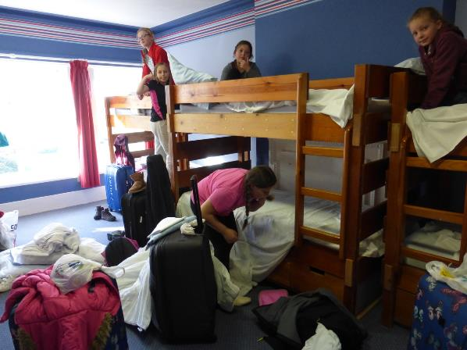
Gain Independence and self reliance

Slide 8
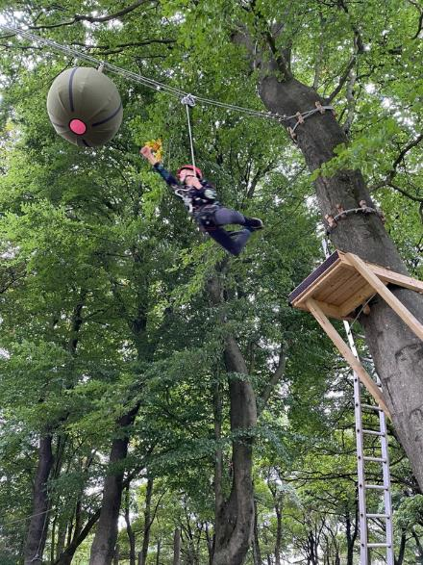
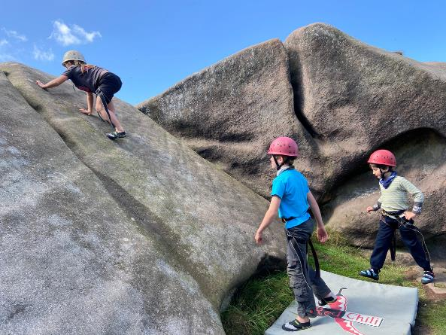
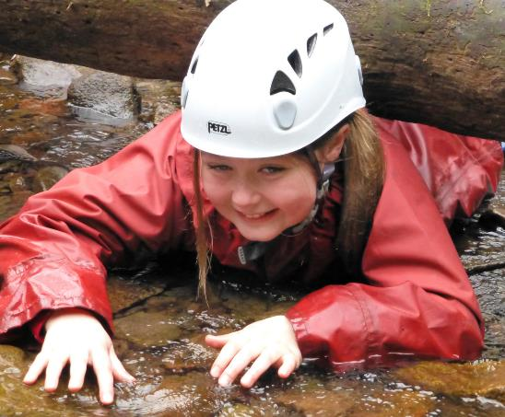
To overcome challenges
and become more confident

Slide 9
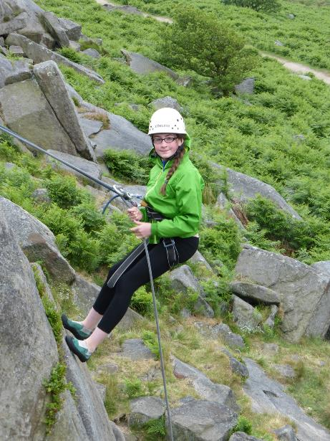
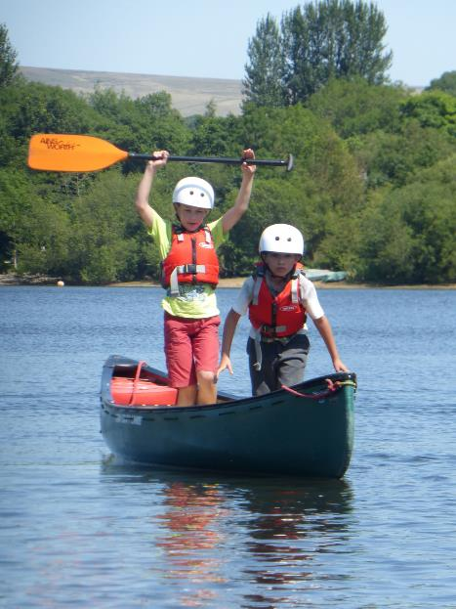
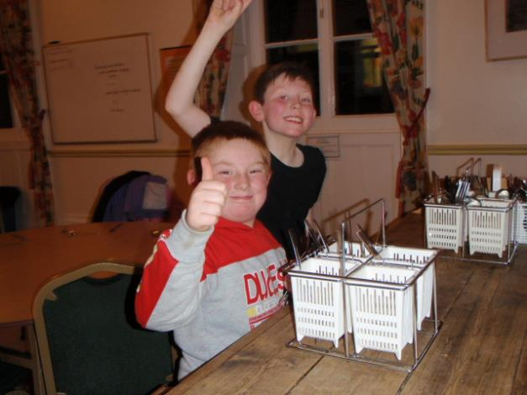
Acheive success and develope a positive attitude

Slide 10


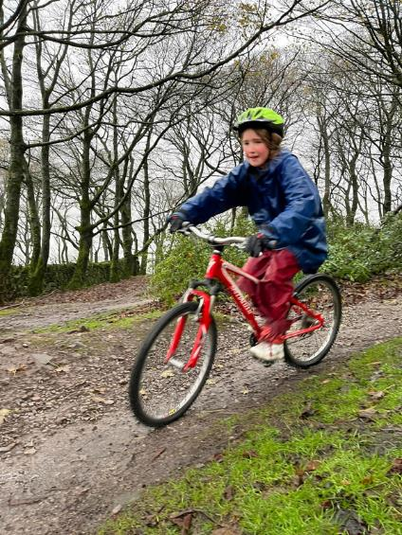
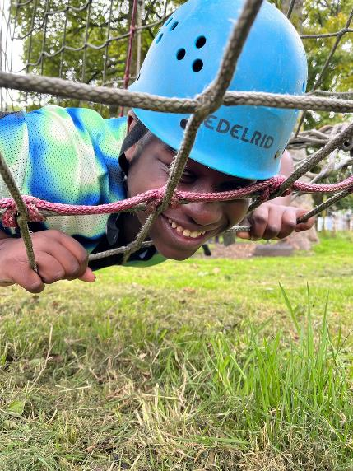
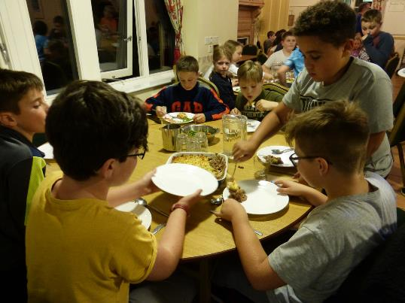

HOW?
FUN
THROUGH ACTIVITIES
THROUGH A SHARED RESIDENTIAL EXPERIENCE

Slide 11

Miss Bennett
(Visit Lead)
Mrs Newton
(Assistant Lead)
Mrs Cockayne
(First Aid & Medication Lead)

Slide 12


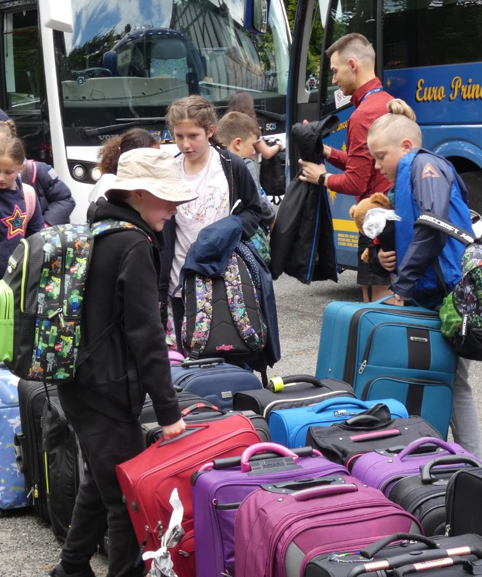
SO WHAT’S YOUR STAY AT WHITE HALL GOING TO BE LIKE?

Slide 13


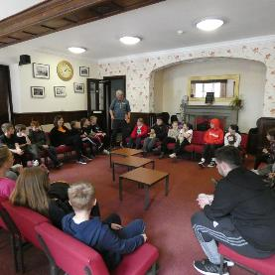
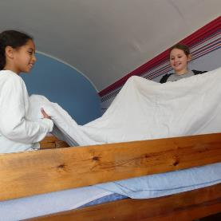
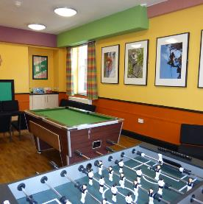
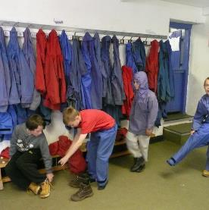
When you arrive there is time :
for a welcome chat
to settle into your dorm and make your beds
get to know the centre
find your peg and get your equipment
Notes:
White Hall works with the school to reinforce all the school values and rules. We have a few extra to help keep everyone safe:
separate girls and boys dormitary areas, no phones or cameras in dorms or changing areas and bedrooms are private spaces just for those people.
All bedding is provided by the centre. We ask children to make their beds helping to foster a sense on independence.
Every child gets their own peg where they can leave waterproofs and boots that they can borrow from White Hall.

Slide 14

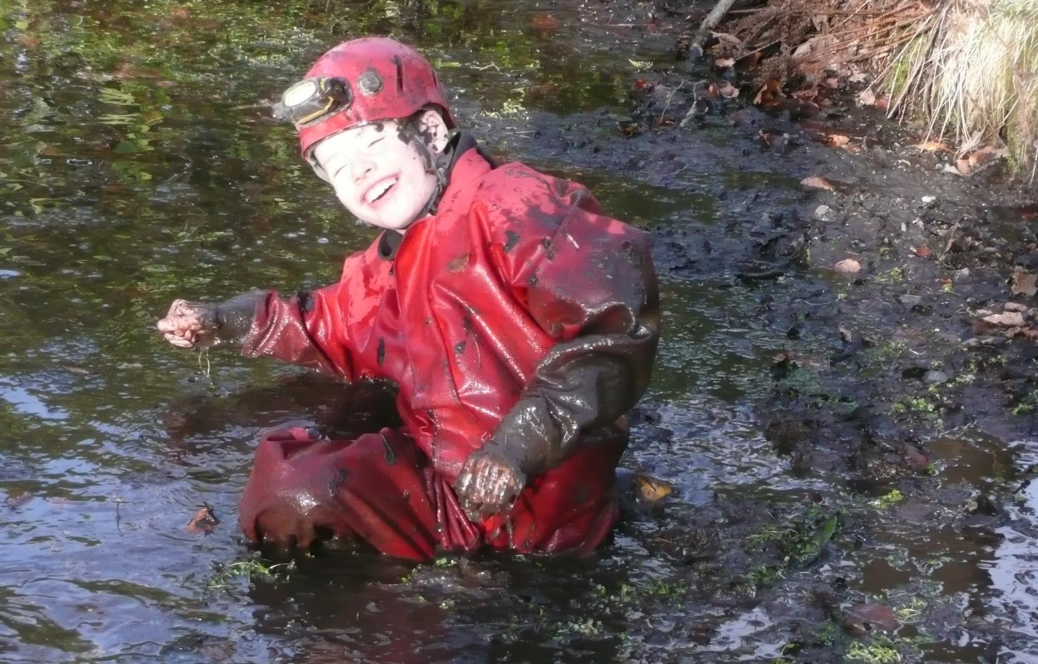
Time to get outside and stuck in!

Slide 15
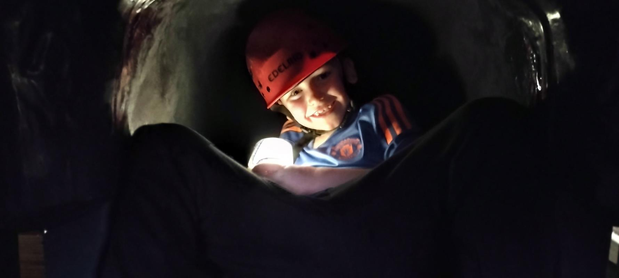
During your stay you may do some of the following .

Slide 16
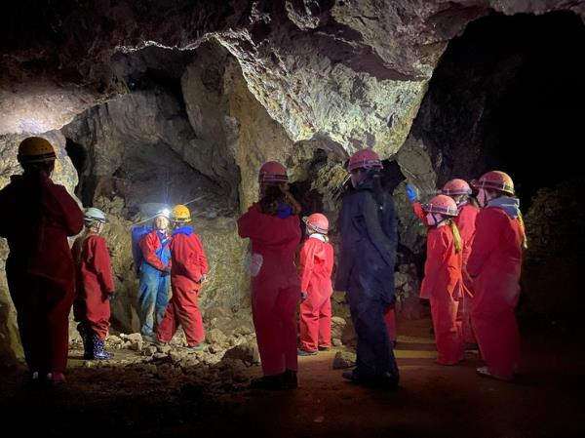
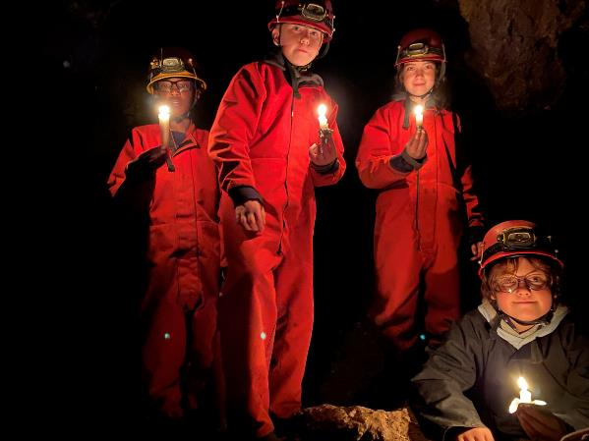
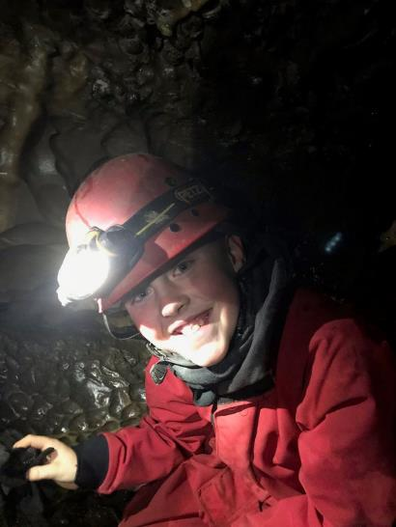
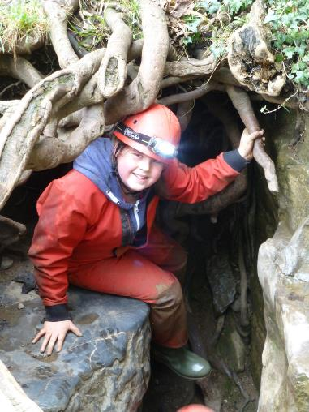
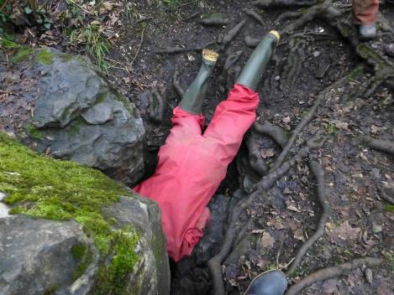
Explore the amazing underground world and overcome fears

Slide 17
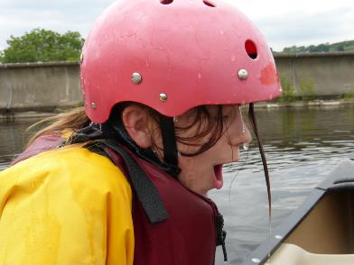
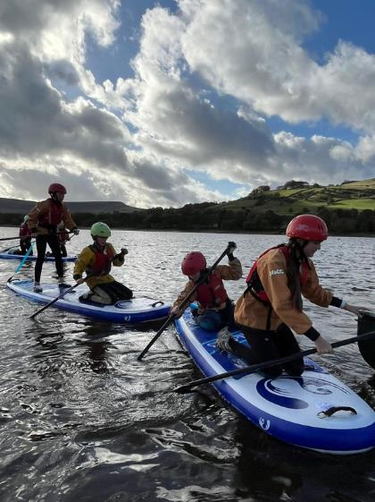
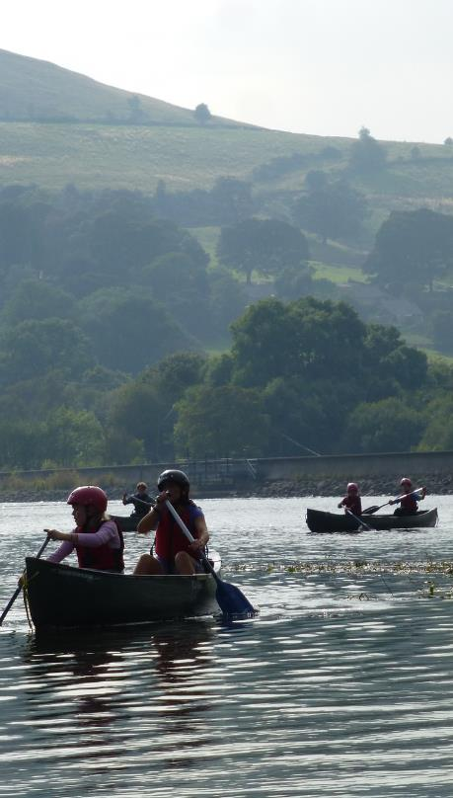
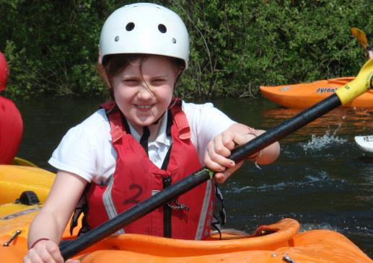
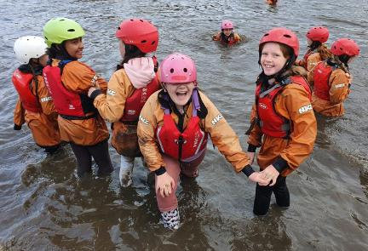
Help your team to paddle in a straight line, journey to the other side of the reservoir and maybe get a little wet!

Slide 18
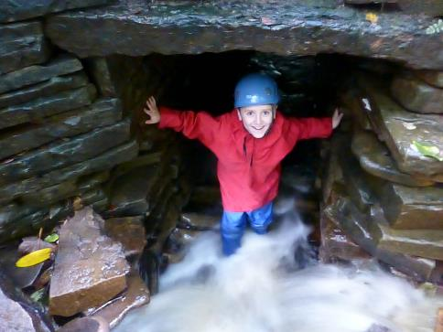

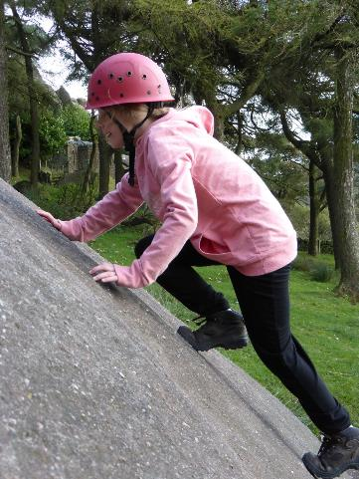
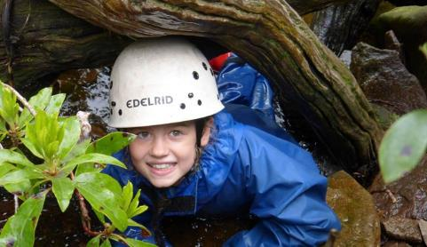
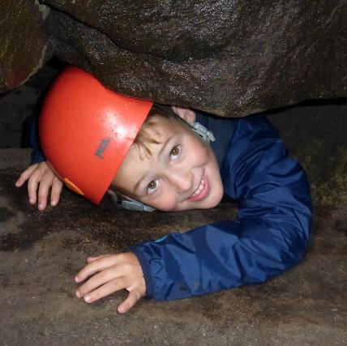
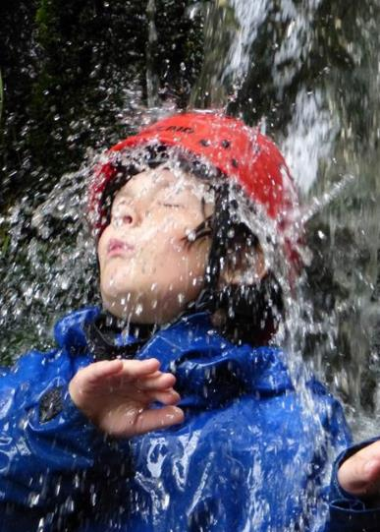


Gain confidence scrambling, whether on the rocks or in the water.

Slide 19




Achieve success on a rope

Slide 20












And so much on site

Slide 21















To keep energy levels up, all White Hall meals are delicious, healthy and home cooked.
And there are a few duties to be done after meals.
Notes:
All meals at White Hall are home cooked. We can cater for any dietary need but we do need advance notice. We are a nut free centre. Meals are family style where everyone sits, serves and chats together.
After meals there are a few simple chores/duties to be done.

Slide 22






THE ADVENTURES DON’T STOP AT TEA.
Night Hike
Wide games
Shelter building
Test your map reading and lead your team on a night walk
Pit your wits against your staff and other teams.
Test your building skills against a “hurricane”

Slide 23



And there is always a little free time.
Notes:
Free time – it is a busy few days but there is some time where children have a bit of time to play, rest, socialise with each other - supervised by school staff.

Slide 24



Then it’s time for supper and bed.
Notes:
Hot chocolate and biscuits.
Bed time to be decided by school staff but we have a general rule of quiet time between 11pm and 7.30am.
There is a member of White Hall staff on duty overnight if there is an emergency.

Slide 25


































What to pack?
Only if you have
for wet activities

Slide 26






Top tips from White Hall
  Name everything
  Learn to make your bed
  Learn how to tie your shoelaces
  Don’t bring anything valuable
Joe Bloggs

Slide 27
Itinerary
We will be leaving St. John’s at midday on Wednesday 19th June.
We depart from White Hall by 1.00 p.m. on Friday 21st June.
Our estimated time of arrival at school should be around 2.15 – 2.30 p.m.
Children will need to be collected, as normal, at 3.30 p.m.

Slide 28

Sandwiches are needed on the day we leave
Please remember to bring a full water bottle for the first day.
White Hall will provide all other meals.

Slide 29

Medication
If your child will be bringing medication to White Hall, you must complete an administration of medicine consent form.
Please hand any medication to Mrs Cockayne, labelled with your child’s name and the dosage, on Monday 17th or Tuesday 18th June by 9:15 a.m. If this isn’t possible, then on the morning of Wednesday 19th June by 9:15 a.m.

Slide 30

Any questions?

Slide 31



